Slide 1

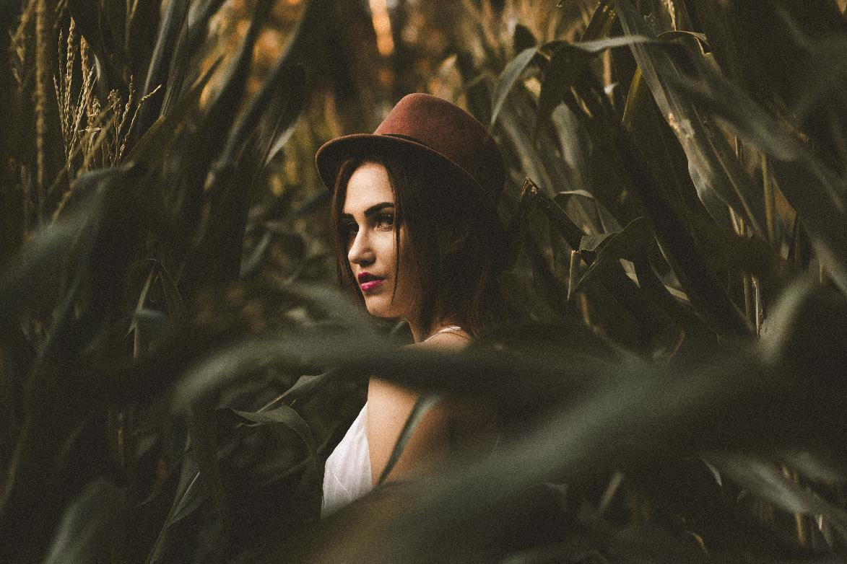

DESIGND BY MUYUESHOP YUEJINFENG SICHUAN
MORIMOTO.COM
Design by Morimoto
MORIMOTO
Here is the copy for Mu Yue's small shop. The copy was updated on June 4, 2020. In the future, I will use this copy in all the PPT layout design of this store. I advise those black-hearted sellers who resell other people's works to do things a bit bottom line and moral. What you infringe is the copyright of others, I have the right to sue you.
This work was carefully designed by Yue Jinfeng, to say something off-topic. Due to the defect of the Taobao platform, my work has been resold by hundreds of merchants on Taobao many times, and there is no way to protect the rights. Use rights in the future.

Slide 2



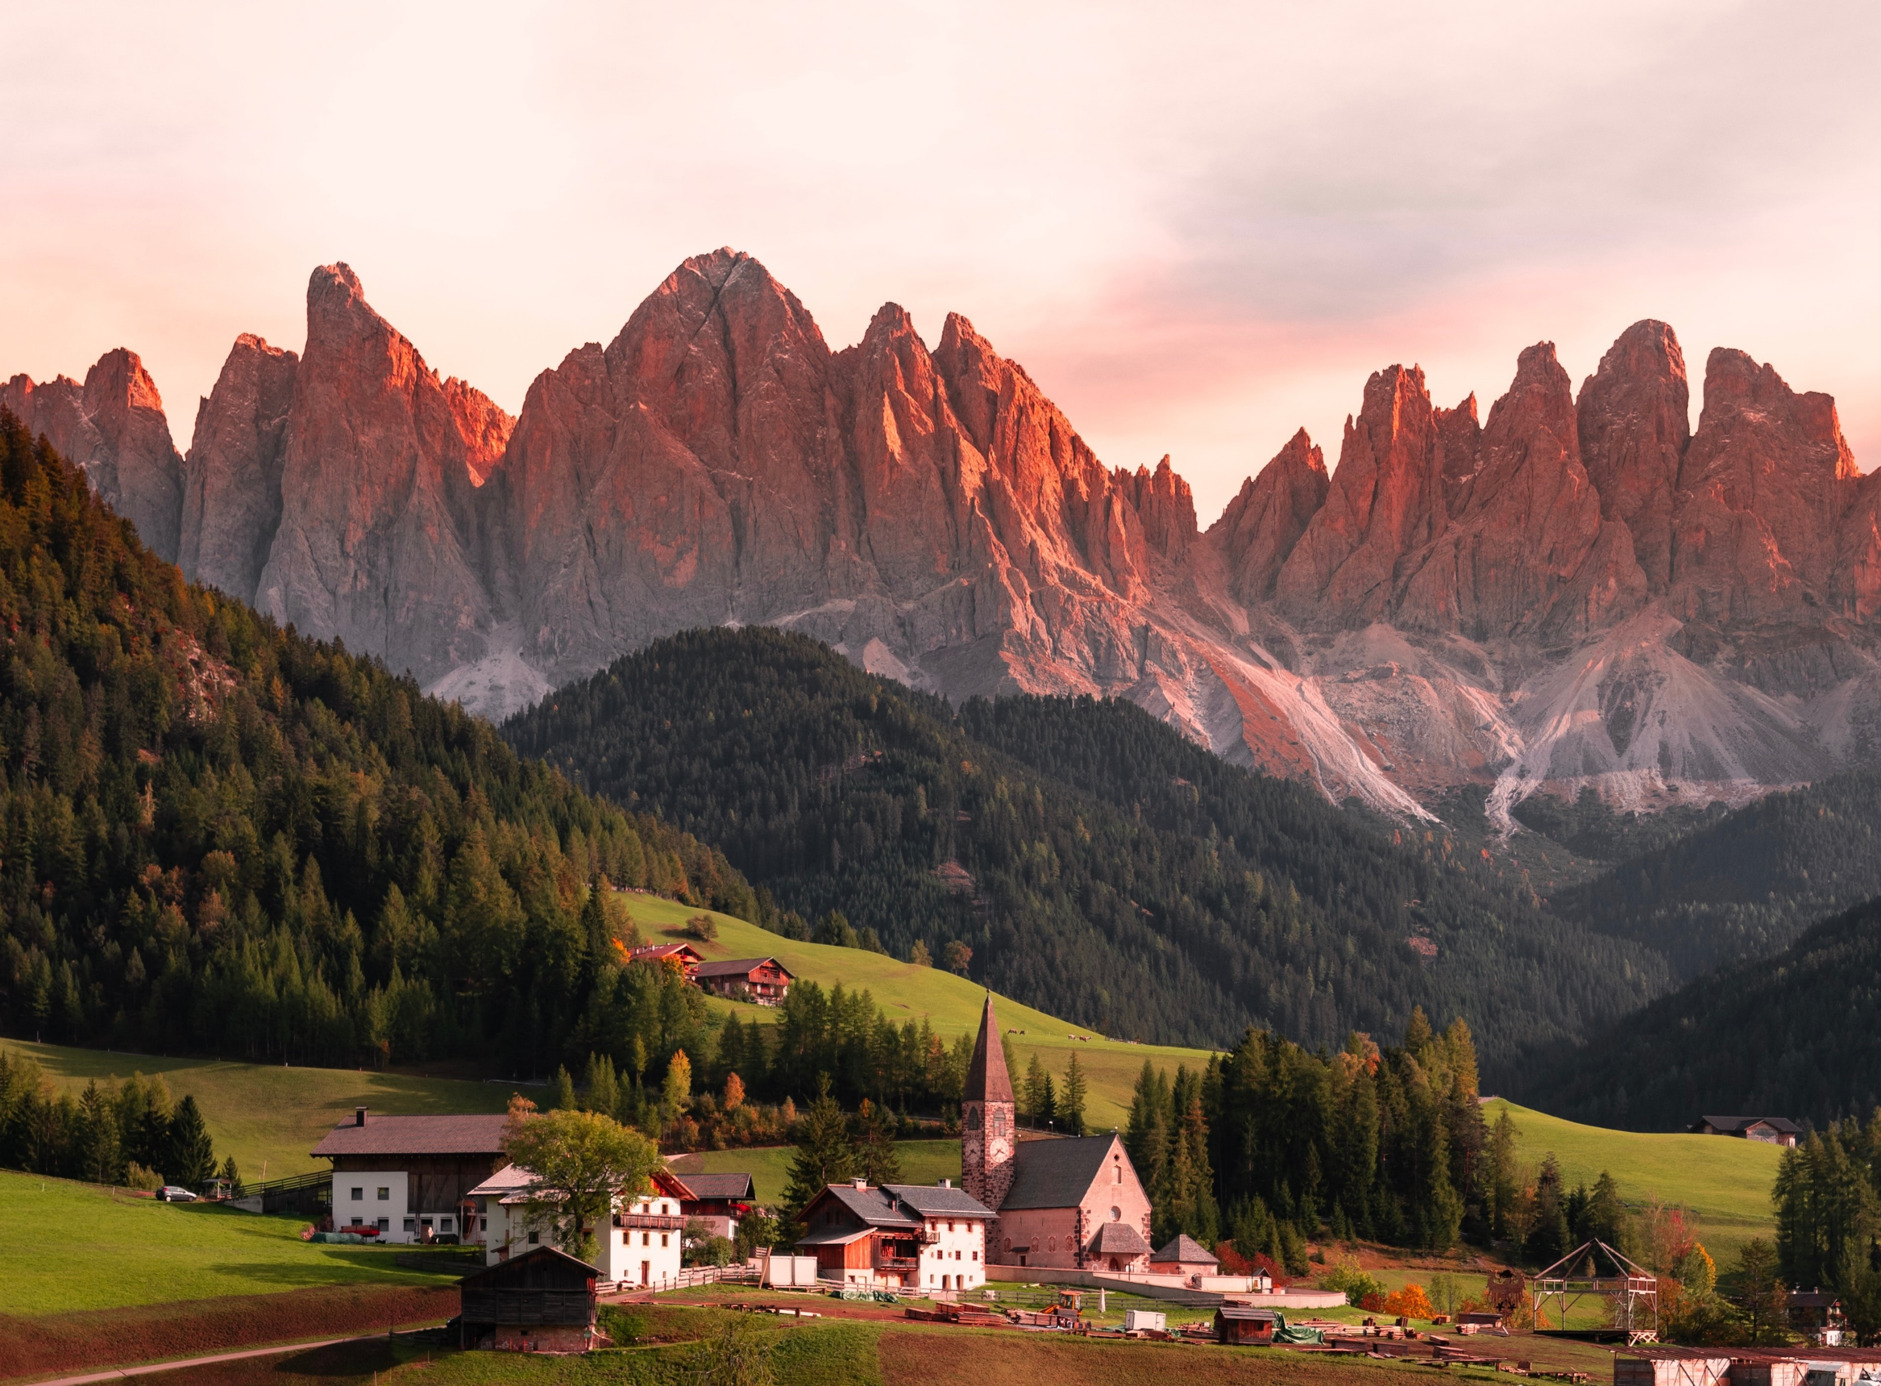
DESIGND BY MUYUESHOP YUEJINFENG SICHUAN
morimoto.com
夏日悸动的心工作汇报模板
Here is the copy for Mu Yue's small shop. The copy was updated on June 4, 2020. In the future, I will use this copy in all the PPT layout design of this store. I advise those black-hearted sellers who resell other people's works to do things a bit bottom line and moral. What you infringe is the copyright of others, I have the right to sue you.
This work was carefully designed by Yue Jinfeng, to say something off-topic. Due to the defect of the Taobao platform, my work has been resold by hundreds of merchants on Taobao many times, and there is no way to protect the rights. Use rights in the future.

Slide 3

DESIGND BY MUYUESHOP YUEJINFENG SICHUAN
01
Your best title text here
Here is the copy for Mu Yue's small shop. The copy was updated on June 4, 2020. In the future, I will use this copy in all the PPT layout design of this store
Your best title text here
02
Here is the copy for Mu Yue's small shop. The copy was updated on June 4, 2020. In the future, I will use this copy in all the PPT layout design of this store
Your best title text here
03
Here is the copy for Mu Yue's small shop. The copy was updated on June 4, 2020. In the future, I will use this copy in all the PPT layout design of this store

Slide 4
DESIGND BY MUYUESHOP YUEJINFENG SICHUAN
morimoto.com
Your best title text here
Here is the copy for Mu Yue's small shop. The copy was updated on June 4, 2020. In the future, I will use this copy in all the PPT layout design of this store
Your best title text here
Here is the copy for Mu Yue's small shop. The copy was updated on June 4, 2020. In the future, I will use this copy in all the PPT layout design of this store

Slide 5
STATISTICS FROM OUR TARGET MARKETS
DESIGND BY MUYUESHOP YUEJINFENG SICHUAN
$2,000,000
Here is the copy for Mu Yue's small shop. The copy was updated on June 4, 2020. In the future, I will use this copy in all the PPT layout design of this store
$1,250,000+
Here is the copy for Mu Yue's small shop. The copy was updated on June 4, 2020. In the future, I will use this copy in all the PPT layout design of this store
80%
Here is the copy for Mu Yue's small shop. The copy was updated on June 4, 2020. In the future, I will use this copy in all the PPT layout design of this store
45%
Here is the copy for Mu Yue's small shop. The copy was updated on June 4, 2020. In the future, I will use this copy in all the PPT layout design of this store

Slide 6
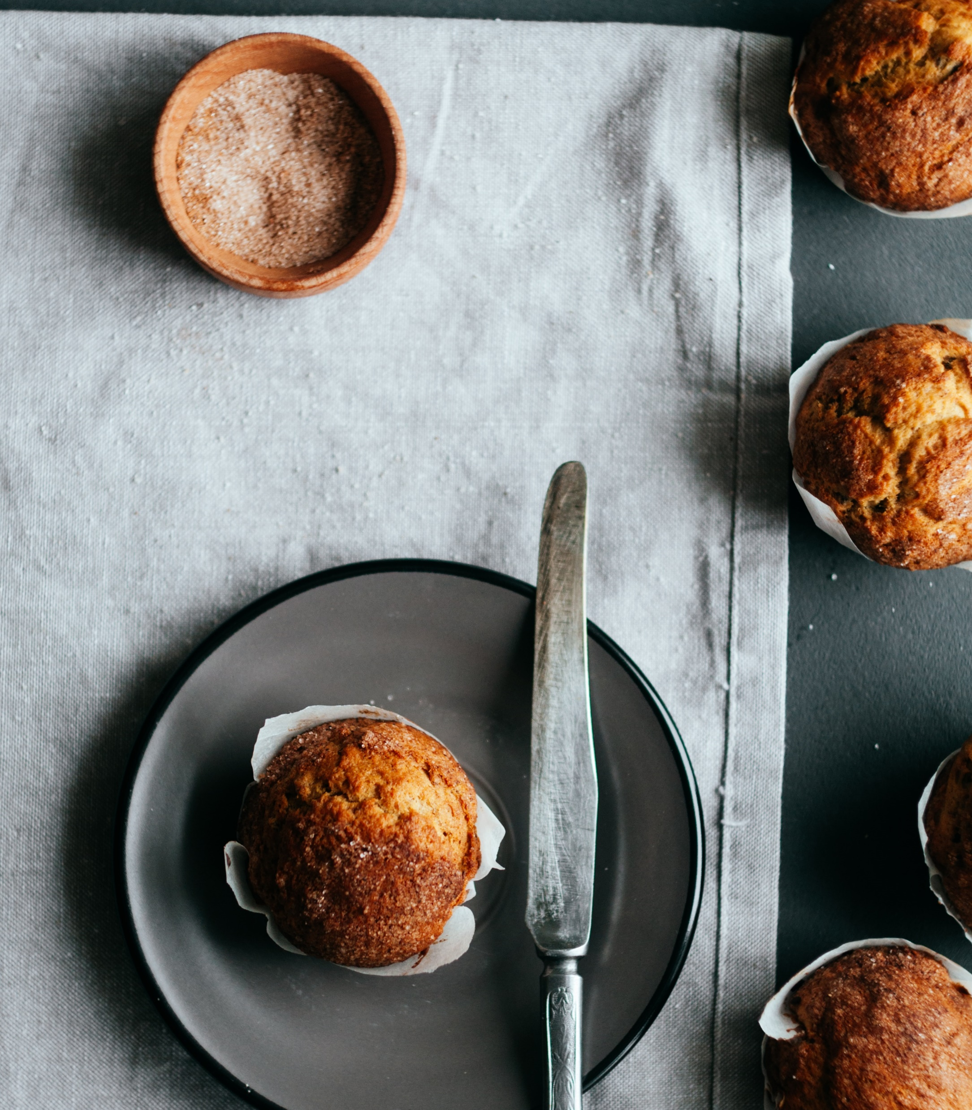
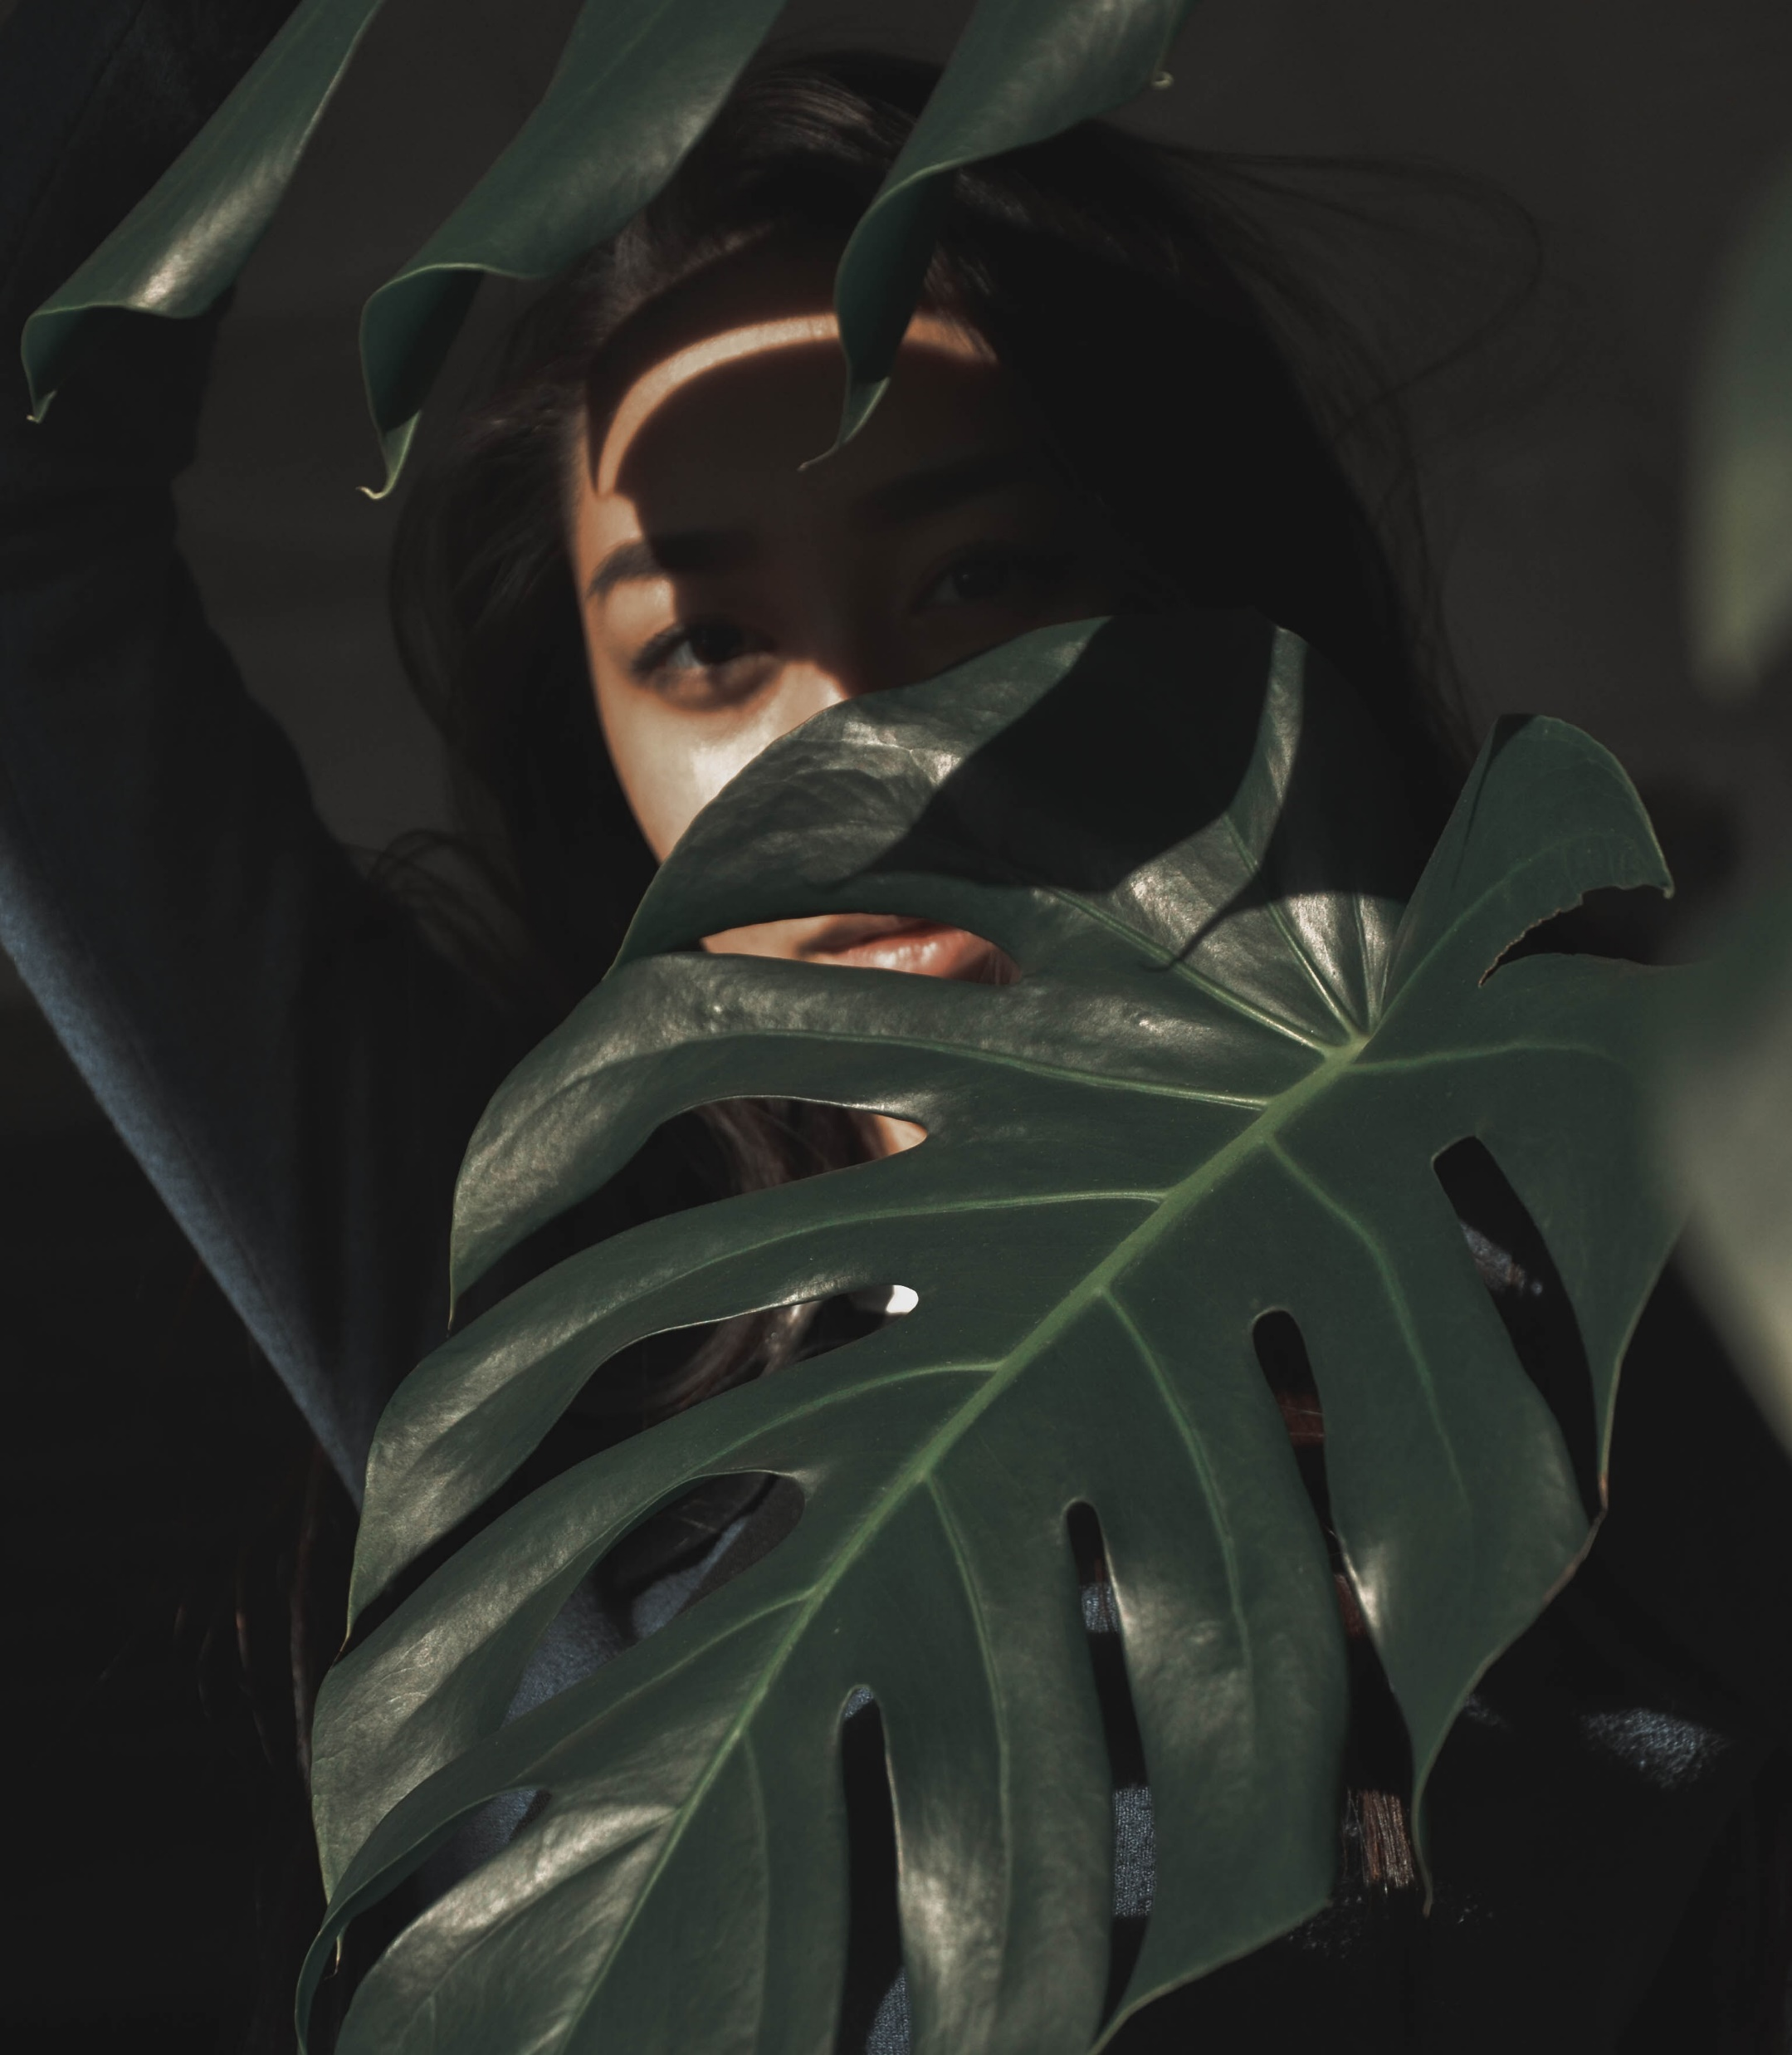
DESIGND BY MUYUESHOP YUEJINFENG SICHUAN
PINTERES
WHO WE ARE
OUR PROCESS
THE STUDIO
Here is the copy for Mu Yue's small shop. The copy was updated on June 4, 2020. In the future, I will use this copy in all the PPT layout design of this store
Here is the copy for Mu Yue's small shop. The copy was updated on June 4, 2020. In the future, I will use this copy in all the PPT layout design of this store
Here is the copy for Mu Yue's small shop. The copy was updated on June 4, 2020. In the future, I will use this copy in all the PPT layout design of this store

Slide 7
INVOICE TABLE DESIGN
DESIGND BY MUYUESHOP YUEJINFENG SICHUAN
 | Unit Cost | Qty / Hr Rate | Tax | Amount
Your Item Name | $12.000.000 | $12.000.000 | $12.000.000 | $12.000.000
Your Item Name | $12.000.000 | $12.000.000 | $12.000.000 | $12.000.000
Your Item Name | $12.000.000 | $12.000.000 | $12.000.000 | $12.000.000
Your Item Name | $12.000.000 | $12.000.000 | $12.000.000 | $12.000.000
TOTAL | $250,000.00 | $86,000.00 | $86,000.00 | $13,000.00

Slide 8
GROWTH GRAPH
DESIGND BY MUYUESHOP YUEJINFENG SICHUAN
Budding Here is the copy for Mu Yue's small shop. The copy was updated on June 4, 2020. In the future, I will use this copy in all the PPT layout design of this store
90.2
Seeding Here is the copy for Mu Yue's small shop. The copy was updated on June 4, 2020. In the future, I will use this copy in all the PPT layout design of this store
Our Growth Rate
0%
100%

Slide 9
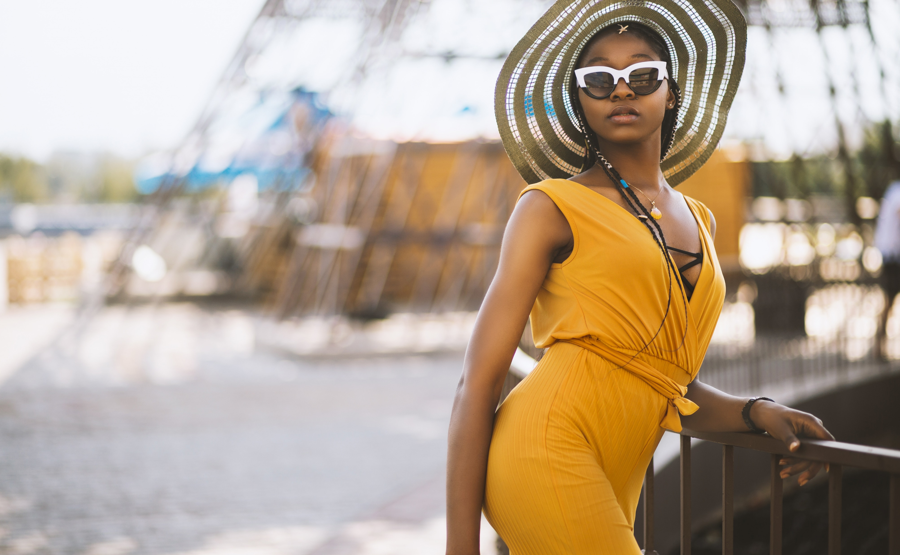

DESIGND BY MUYUESHOP YUEJINFENG SICHUAN
WHO WE ARE
Here is the copy for Mu Yue's small shop. The copy was updated on June 4, 2020. In the future, I will use this copy in all the PPT layout design of this store
Here is the copy for Mu Yue's small shop. The copy was updated on June 4, 2020. In the future, I will use this copy in all the PPT layout design of this store
OUR PROCESS
THE STUDIO

Slide 10
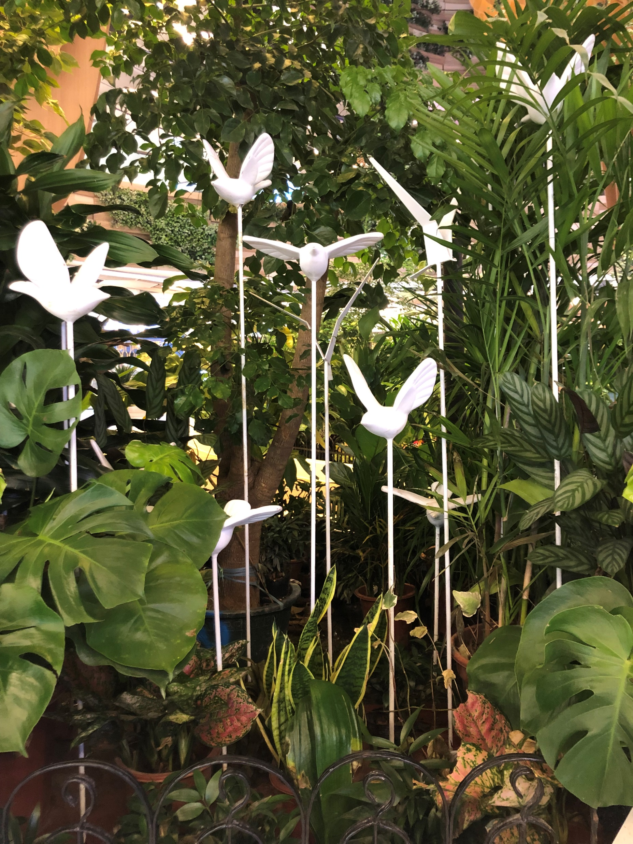
WHO WE ARE
OUR PROCESS
THE STUDIO
Here is the copy for Mu Yue's small shop. The copy was updated on June 4, 2020. In the future, I will use this copy in all the PPT layout design of this store
Here is the copy for Mu Yue's small shop.

Slide 11

WHO WE ARE
Here is the copy for Mu Yue's small shop. The copy was updated on June 4, 2020. In the future, I will use this copy in all the PPT layout design of this store
Here is the copy for Mu Yue's small shop. The copy was updated on June 4, 2020. In the future, I will use this copy in all the PPT layout design of this store
OUR PROCESS
THE STUDIO
Here is the copy for Mu Yue's small shop. The copy was updated on June 4, 2020. In the future, I will use this copy in all the PPT layout design of this store
Here is the copy for Mu Yue's small shop. The copy was updated on June 4, 2020. In the future, I will use this copy in all the PPT layout design of this store

Slide 12

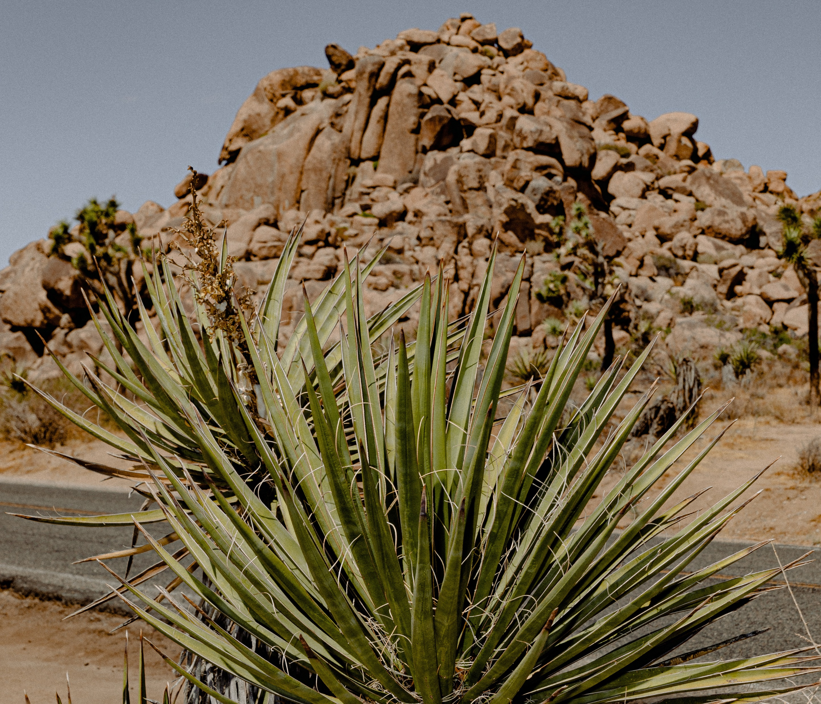
WHO WE ARE
OUR PROCESS
THE STUDIO
Here is the copy for Mu Yue's small shop. The copy was updated on June 4, 2020
Here is the copy for Mu Yue's small shop. The copy was updated on June 4, 2020. In the future, I will use this copy in all the PPT layout design of this storeHere is the copy for Mu Yue's small shop. The copy was updated on June 4, 2020. In the future, I will use this copy in all the PPT layout design of this store
Here is the copy for Mu Yue's small shop. The copy was updated on June 4, 2020. In the future, I will use this copy in all the PPT layout design of this store

Slide 13
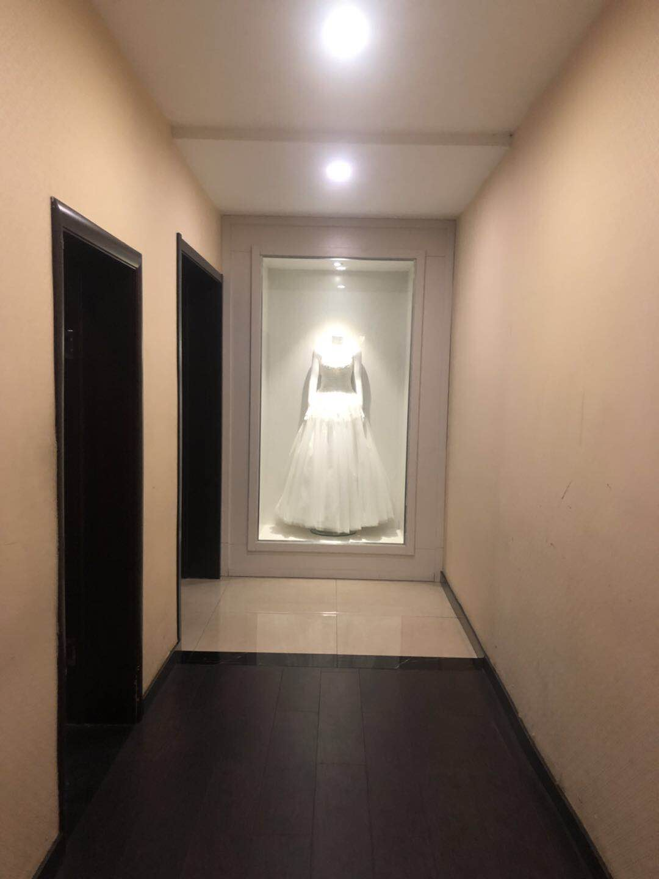
Here is the copy for Mu Yue's small shop. The copy was updated on June 4, 2020. In the future, I will use this copy in all the PPT layout design of this storeHere is the copy for Mu Yue's small shop. The copy was updated on June 4, 2020. In the future, I will use this copy in all the PPT layout design of this store

Slide 14
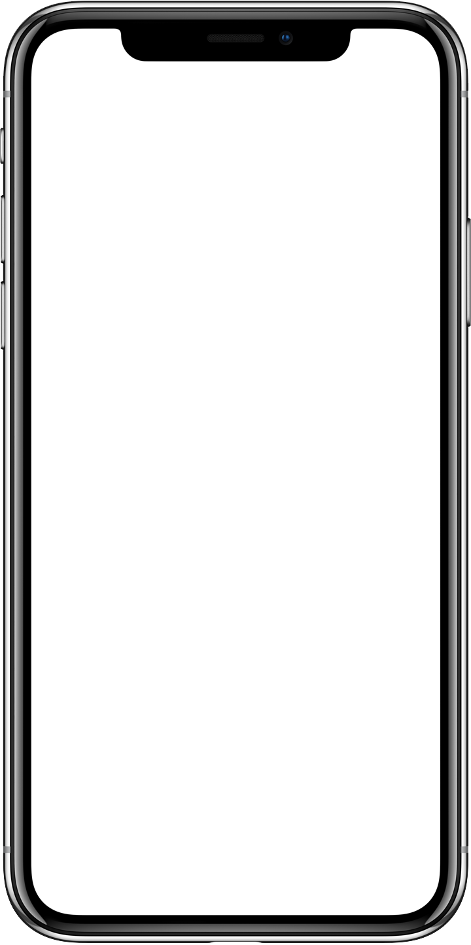
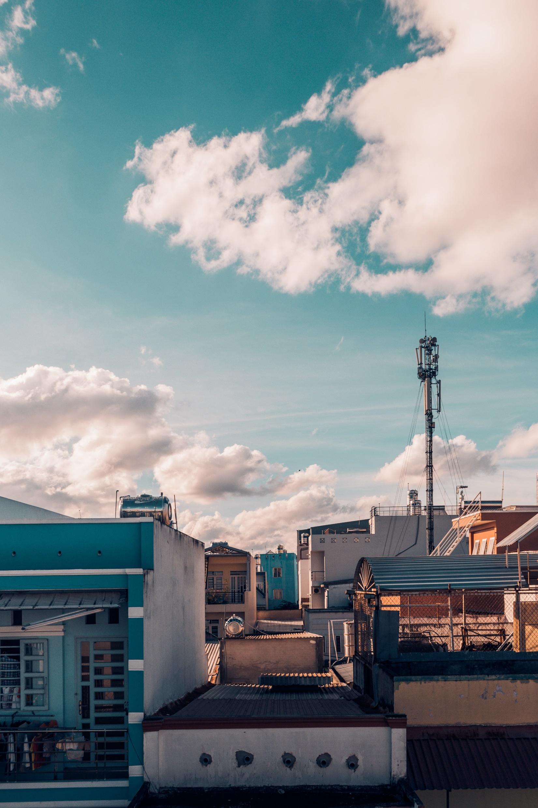
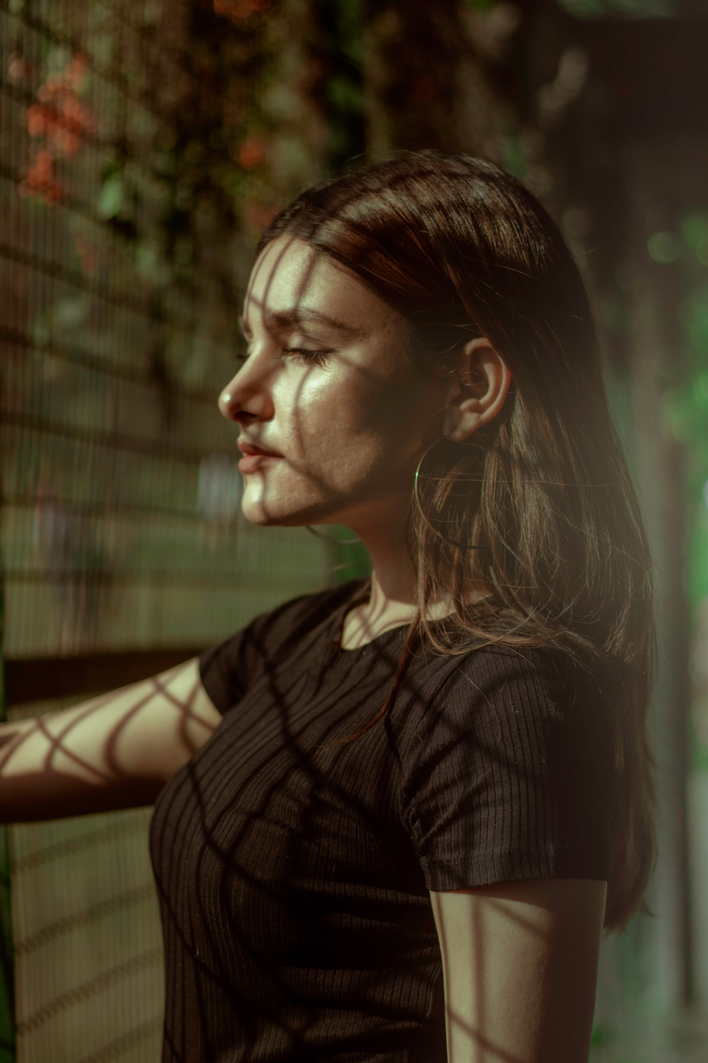


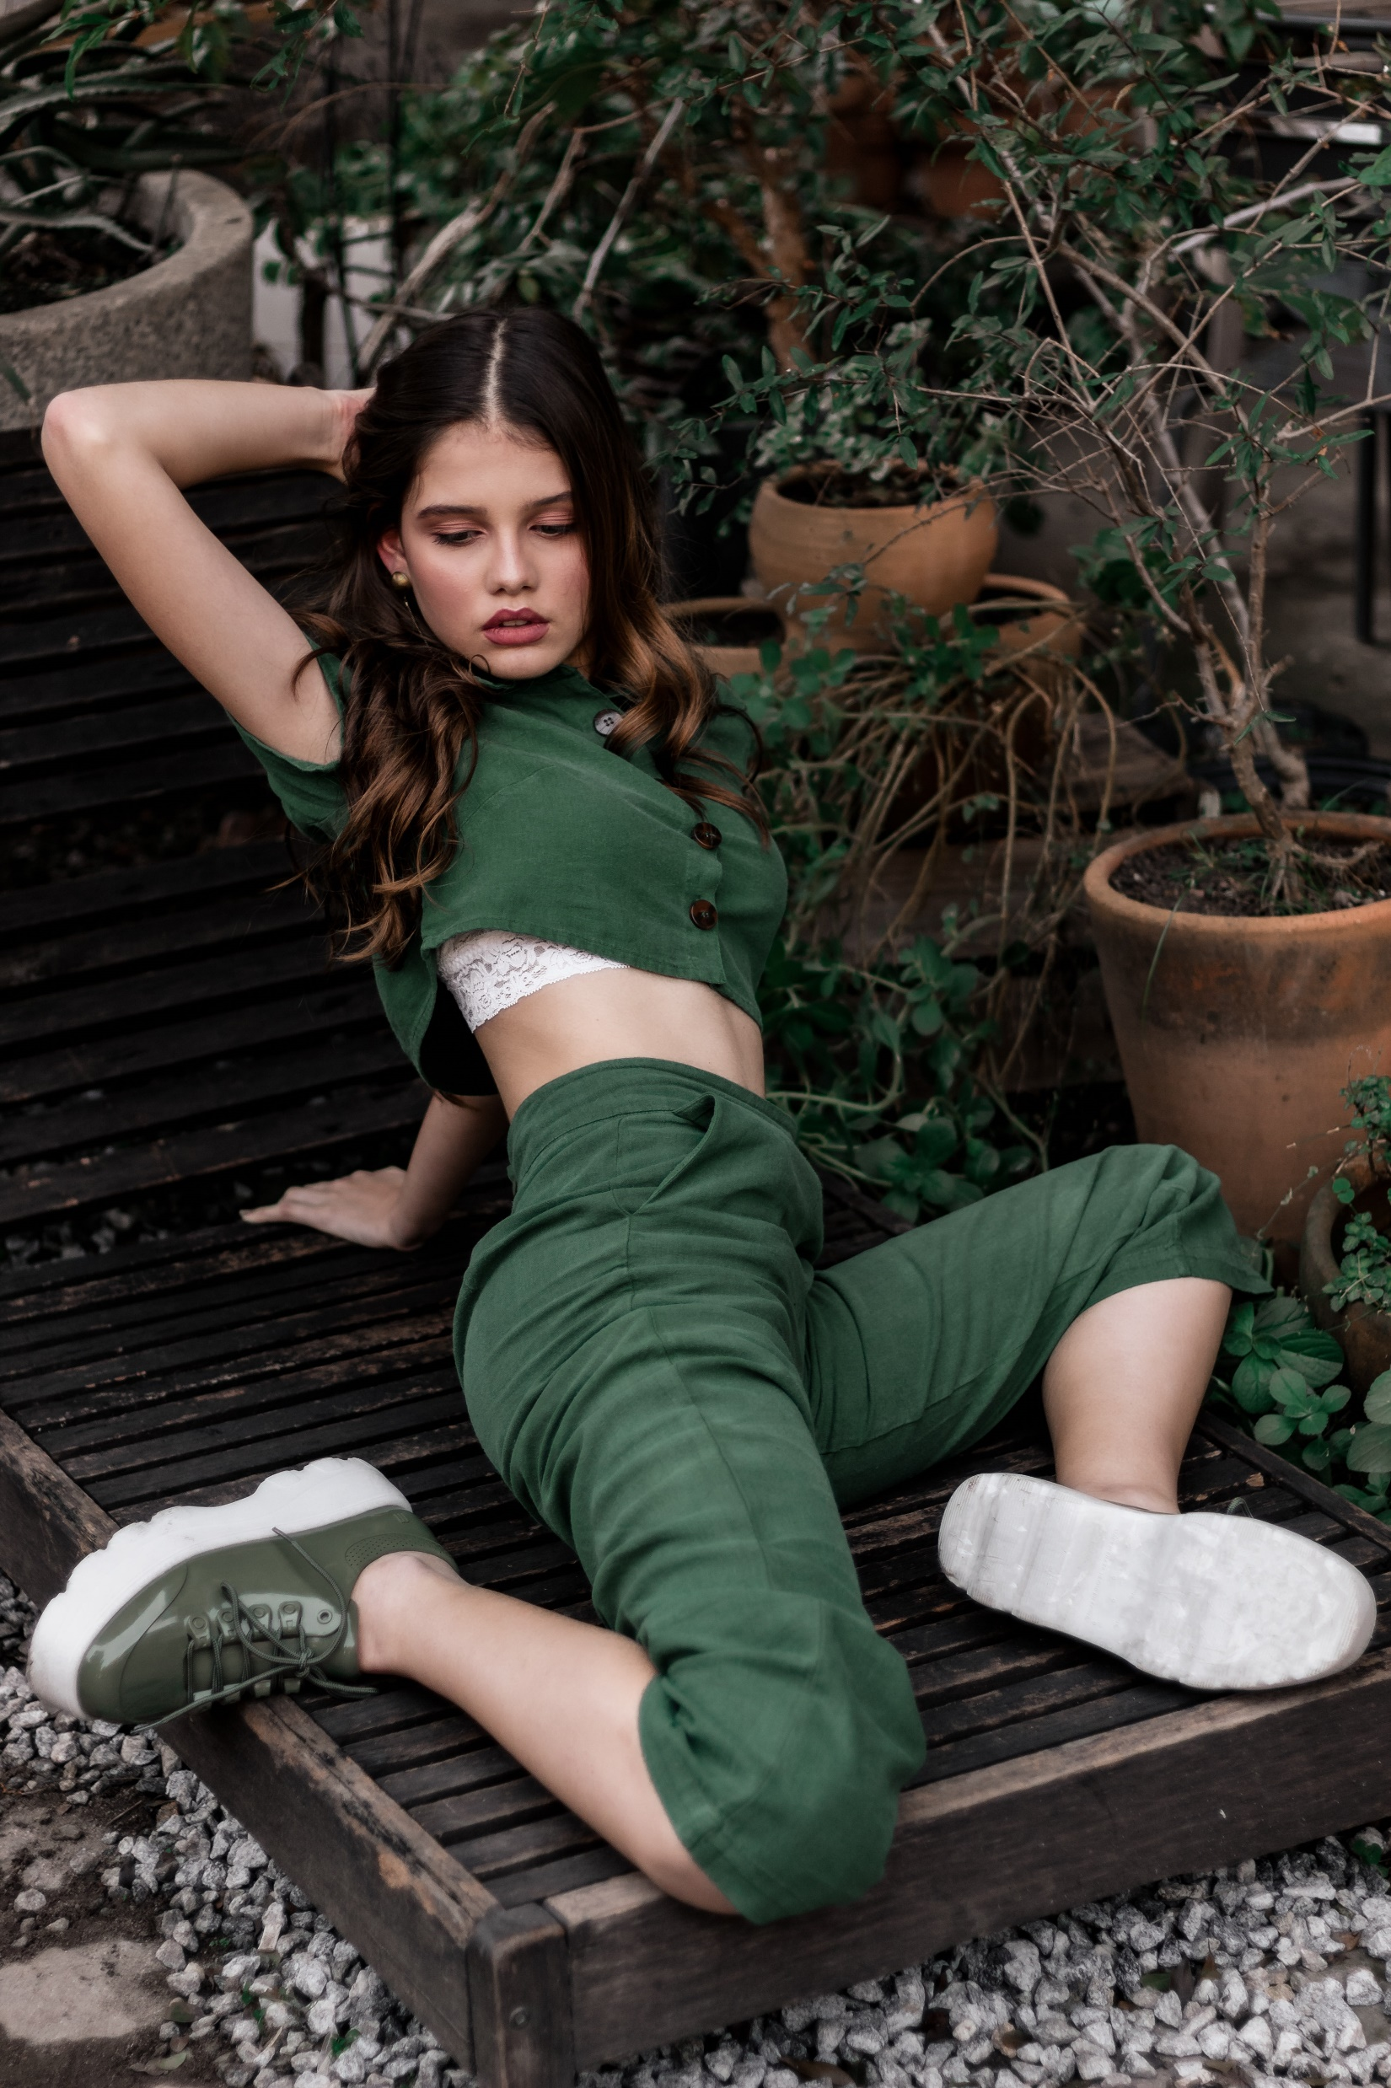
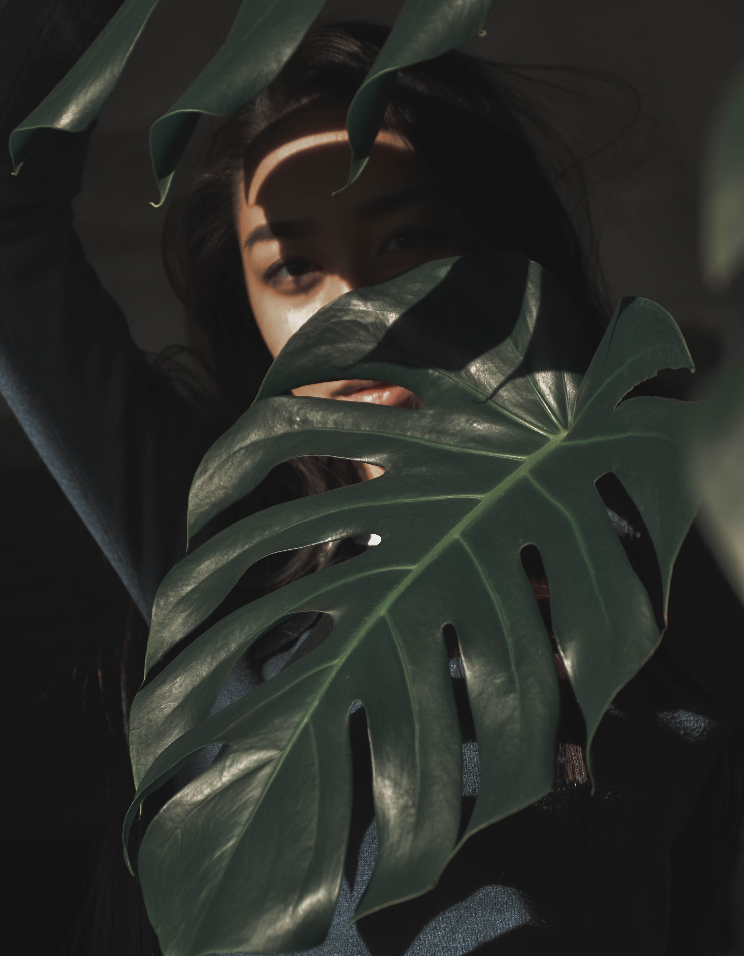
DESIGND BY MUYUESHOP YUEJINFENG SICHUAN
WHO WE ARE
OUR PROCESS
THE STUDIO
Here is the copy for Mu Yue's small shop. The copy was updated on June 4, 2020. In the future, I will use this copy in all the PPT layout design of this store

Slide 15
DESIGND BY MUYUESHOP YUEJINFENG SICHUAN
morimoto.com
THANKS FOR
WATCHING
Here is the copy for Mu Yue's small shop. The copy was updated on June 4, 2020. In the future, I will use this copy in all the PPT layout design of this store. I advise those black-hearted sellers who resell other people's works to do things a bit bottom line and moral. What you infringe is the copyright of others, I have the right to sue you.
This work was carefully designed by Yue Jinfeng, to say something off-topic. Due to the defect of the Taobao platform, my work has been resold by hundreds of merchants on Taobao many times, and there is no way to protect the rights. Use rights in the future.

